Slide 1
Truhealth 360 Cancer Screen
Colour Palette
Hex #146930
Hex #00984A
Hex #65b32E
Hex #65b32E
Hex #E6E24A
Hex #E6E24A
Hex #ffffff
Hex #1d1d1b
Male and female Profiles

Slide 2
Test details
Test code : T8737
Test Name: Truhealth Cancer Screen 360 Male
Price: 17,000/-
Test code : T8736
Test Name: Truhealth Cancer Screen 360 Female
Price: 17,000/-
3 Layers of Screening
Basic Tumor Markers
Hereditary cancer panel
Prostate Cancer Screening ( PSA)
3 Layers of Screening
Basic Tumor Markers
Hereditary cancer panel
Cervical Cancer Screening ( Kit)

Slide 3
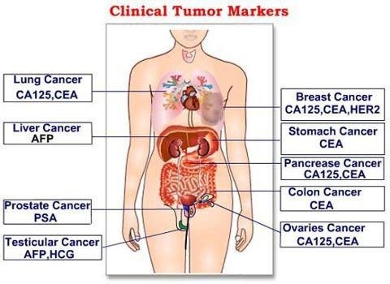
Basic Screening Markers

Slide 4
Ideal Tumor Marker
Cancer | Marker | Recommended Use
Breast | CA-15.3 | Monitoring
Carcinoid | 5-HIAA | Diagnosis
Hepatoma/Liver Cancer | AFP | Screening, Diagnosis, Prognosis, Monitoring
Gastrointestinal | CEA, CA-19.9 | Prognosis, Management
Ovary | CA-125 | Prognosis, Management
Prostate | PSA, PAP (Prostatic acid phosphatase) | Prognosis, Diagnosis, Monitoring
Germ Cell Tumour | AFP, Beta-HCG | Diagnosis, Prognosis
Choriocarcinoma | Beta-HCG | Diagnosis, Prognosis
Thyroid | Thyroglobulin | Screening & Monitoring

Slide 5
Introduction
Tumour markers are substances present in the tumour, produced by the tumour itself or by the host, as a response to presence of tumour, providing biological information about tumour.
Quantitative determination:- in serum or biological fluids, whose concentrations are proportionate to genesis & growth of malignant tumours
Qualitative determination:- Histopathological.
Thus tumour markers can be antigens or enzymes or are hormones and are tissue specific.

Slide 6
Ideal Tumour Marker
Ideal tumour marker should be highly specific, i.e. specific of one Pathology, should be highly sensitive, i.e. cut off should be low, should have a short half life, which helps in follow up, also it should be reducing during treatment & increase during relapse.
Thus tumour markers are useful in diagnosis as well as in monitoring the treatment

Slide 7
Hereditary Cancer
Hereditary cancer refers to cancer that is passed down through families due to inherited genetic mutations.
These mutations are inherited from a parent and can be found in multiple family members across generations.
Hereditary cancers result from mutations in specific genes that increase the risk of developing cancer.

Slide 8

Signs of Hereditary Cancers
Covers 317 Genes
More than 25 cancer types and rare cancer screening
Early age of diagnosis
Family history of the same or related types of cancer
eg. breast and ovarian; colon, Prostate and endometrial
Multiple primary cancers, including bilateral breast cancers
Rare cancers
eg. Male breast, fallopian tube, triple-negative breast cancer
Ancestry
eg. Ashkenazi Jewish and BRCA1 and BRCA2

Slide 9

Identifying Hereditary Cancer is Important
Genetic Risk Assessment = Personalized Medicine
Early Detection & Prevention
Personalized Treatment Plans
Family Risk Assessment
Reducing Unnecessary Anxiety
Average
Standard screening and risk reduction
Family History
+
Genetic Testing
Moderate
(“Familial”)
Personalized screening
and risk reduction
Genetic evaluation with personalized
screening, risk reduction,
and treatment
High/Genetic

Slide 10
What is Prostate Cancer ?
It is the tumour that begins in the prostate gland when cells make too much of protein called as Prostate specific antigen (PSA) Some Cancers grow slowly and don’t cause symptoms for years however if untreated can spread quickly
Am I At Risk?
1 IN 8 Men in India will develop Prostate cancer
Men Aged 40+ Need to test
Symptoms
Frequent urination, especially at night Leaking urine Pain or burning during urination or ejaculation Bloody urine Pain in lower back, upper thighs Straining to pass urine
How is PSA Tested ?
A blood sample is taken and sent to a lab The higher the PSA result, the greater the chance of prostate cancer Elevated PSA doesn’t always mean prostate cancer is present.
The test is very reliable combined with a digital rectum exam.

Slide 11
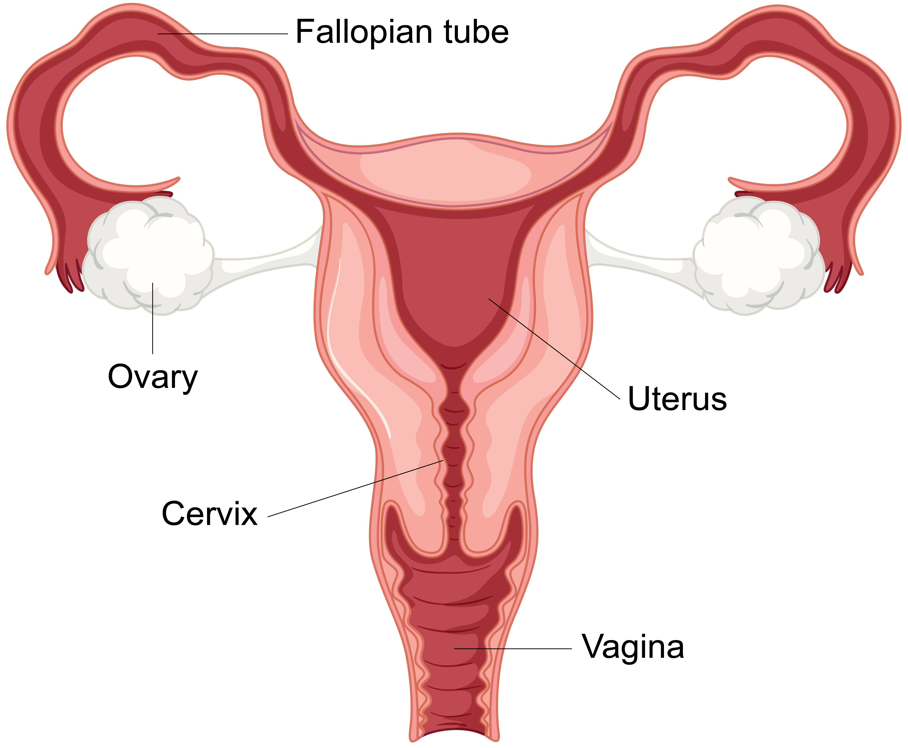
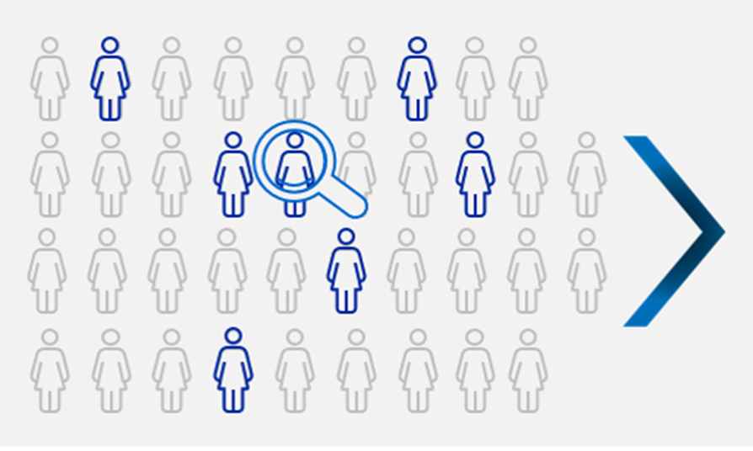
What is cervical cancer?
The cervix is the lower, narrow end of the uterus (womb). The cervix connects the uterus to the vagina (birth canal). Cervical cancer is the cancer or tumor of the cells around the cervix. Cervical cancer is the 4th most common cancer in women (WHO 2022)
What causes cervical cancer?
99% cervical cancer cases are linked to infection with high-risk human papillomaviruses (HPV), an extremely common virus transmitted through sexual contact. HPV infections usually resolve spontaneously & cause no symptoms, persistent infection can cause cervical cancer in women.
Hence effective primary prevention (screening at recommended regular intervals is essential )
How is HPV diagnosed?
By clinical examination, PAP smear, Cytology (LBC), Histopath & Molecular Biology (HPV DNA)
Cervix connects the uterus to the vagina (birth canal). Cervical cancer is cancer that starts in the cells of the cervix, ie the lower, narrow end of the uterus (womb).

Slide 12


Why do women not undergo cervical screening?
Barriers to cervical examination/ PAP test
Lack of awareness
Fear of positive result
Fear & Anxiety to visit gynaec
Busy OPD
Lack of clinic access
Lack of time
To overcome this hurdle WHO recommends

Slide 13
Primary Cervical Cancer Screening High Risk HPV detection
>> self-sampling kit
FAQs
Who should get this test done?
WHO recommends all women between 30Y to 65Y should undergo cervical cancer screening every 5 to 10yrs.
Did this test have regulatory approval?
Yes it is an FDA approved test.

Slide 14
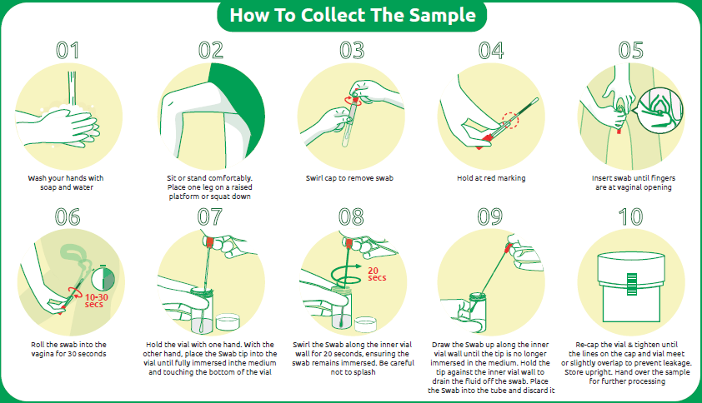
How to collect samples for Cervical Cancer using HPV self-testing kit?
Women may collect their own vaginal sample at the collection cetre or in the comfort of their home. The below mentioned steps need to be followed.

Slide 15
What happens if my test result is positive?
A positive result indicates the presence of high-risk HPV genotypes. Please consult the gynaecologist for clinical correlation and further testing.
Is HPV self-collection a replacement for clinician-collected cervical cancer screening?
No, HPV self-collection is intended for women who never went for screening and to overcome barriers associated with traditional way of clinician-collected screening.

Slide 16
Thank you

