Slide 1
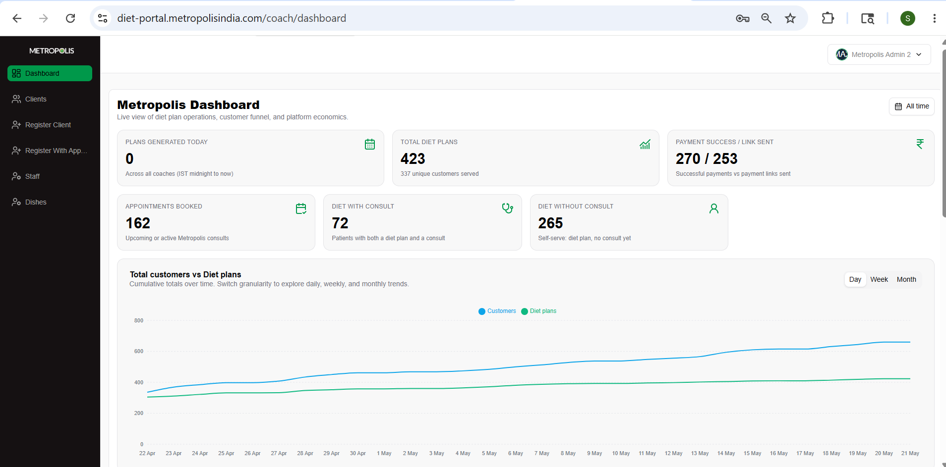

Slide 2
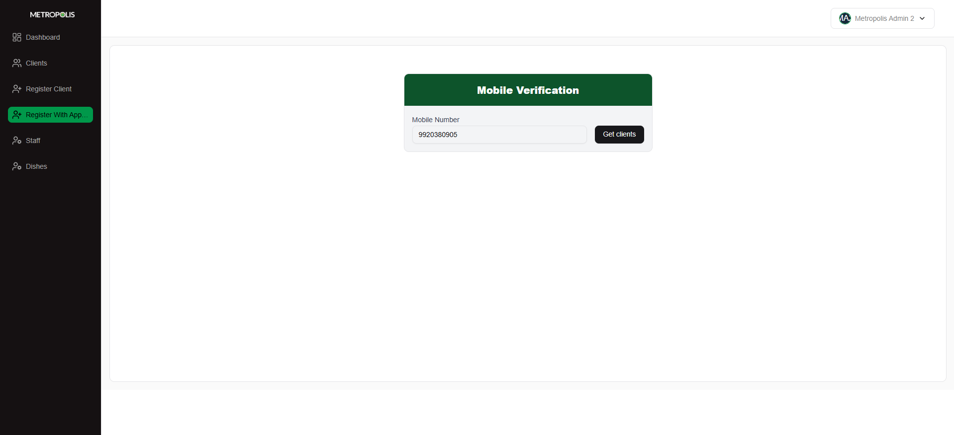
Notes:
First Time Patient Registration

Slide 3
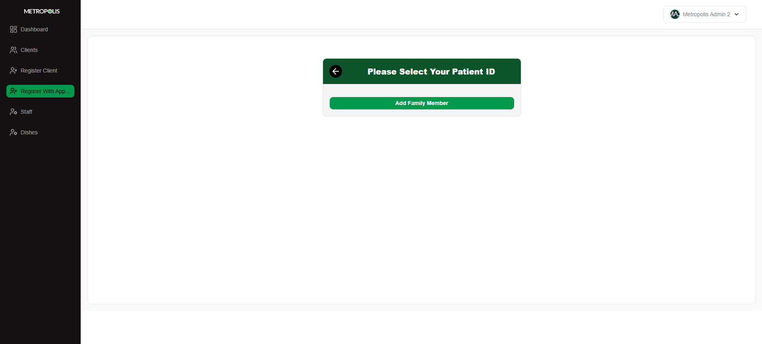
Notes:
As no details are available for this new Patient, the details can be added by Agent.

Slide 4
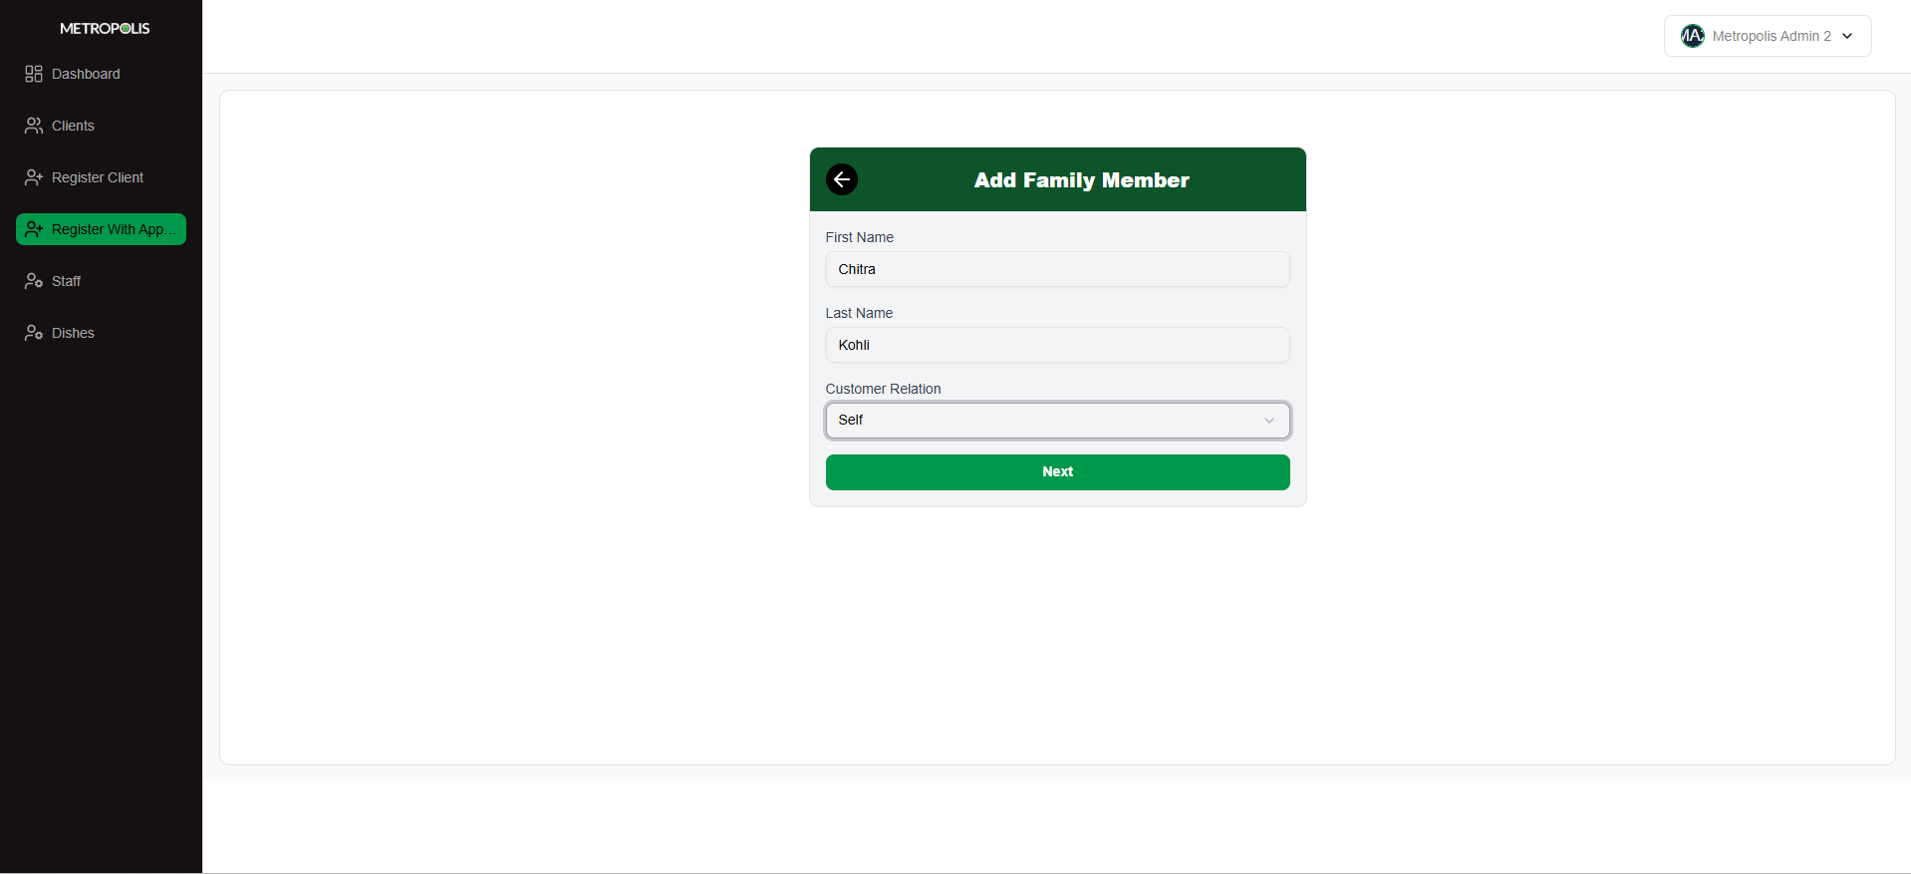

Slide 5
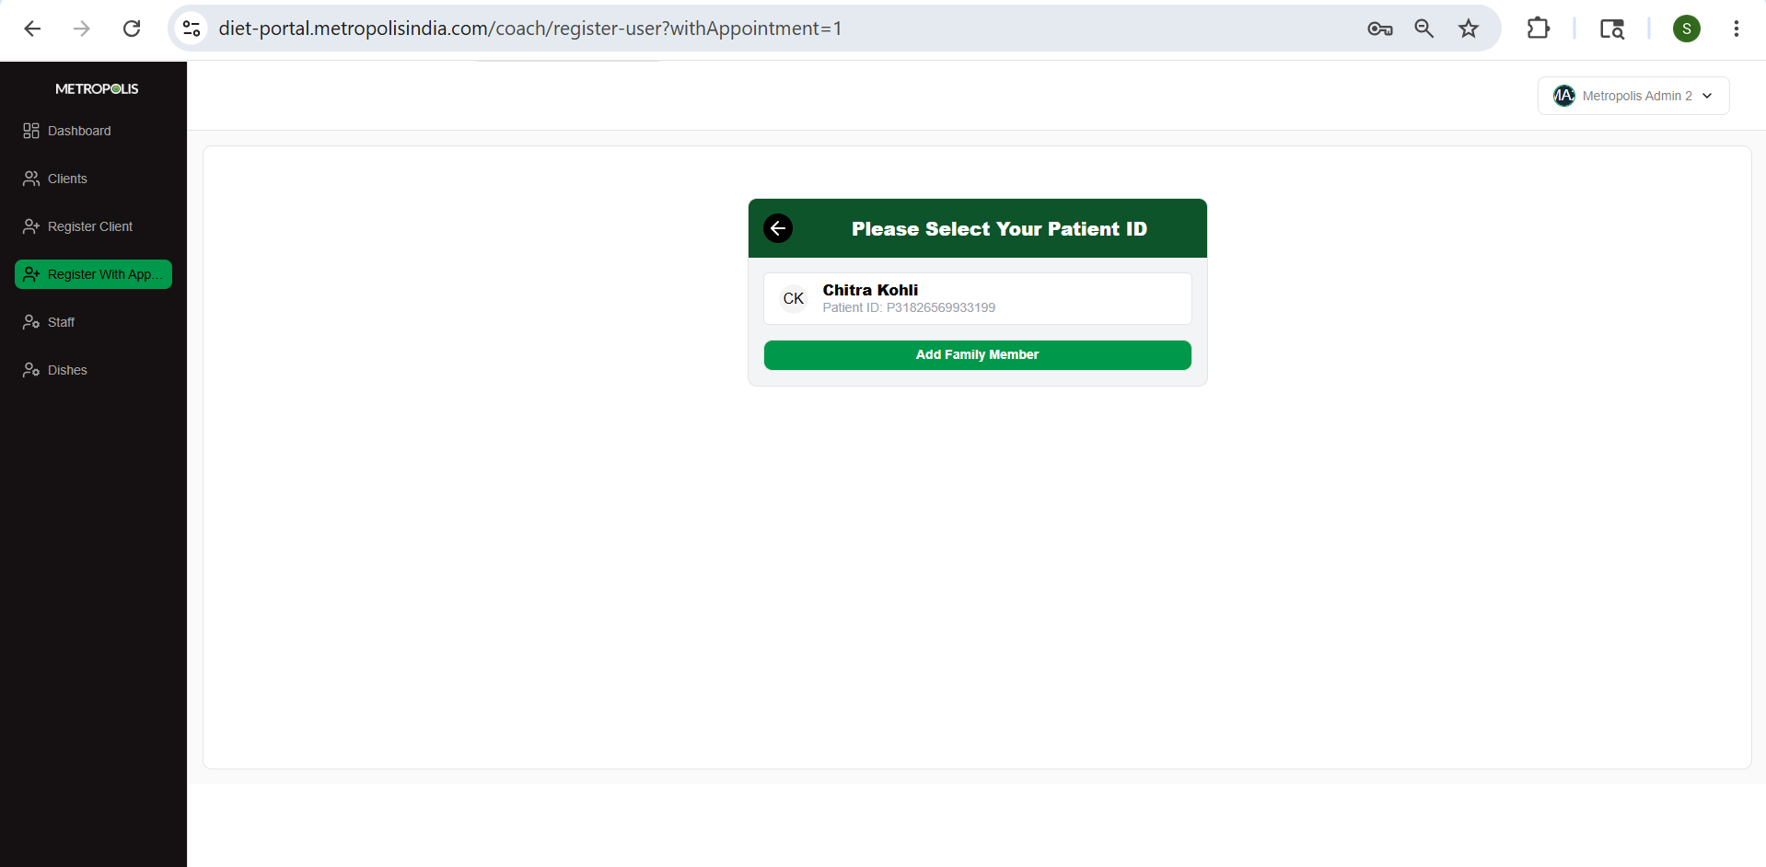

Slide 6
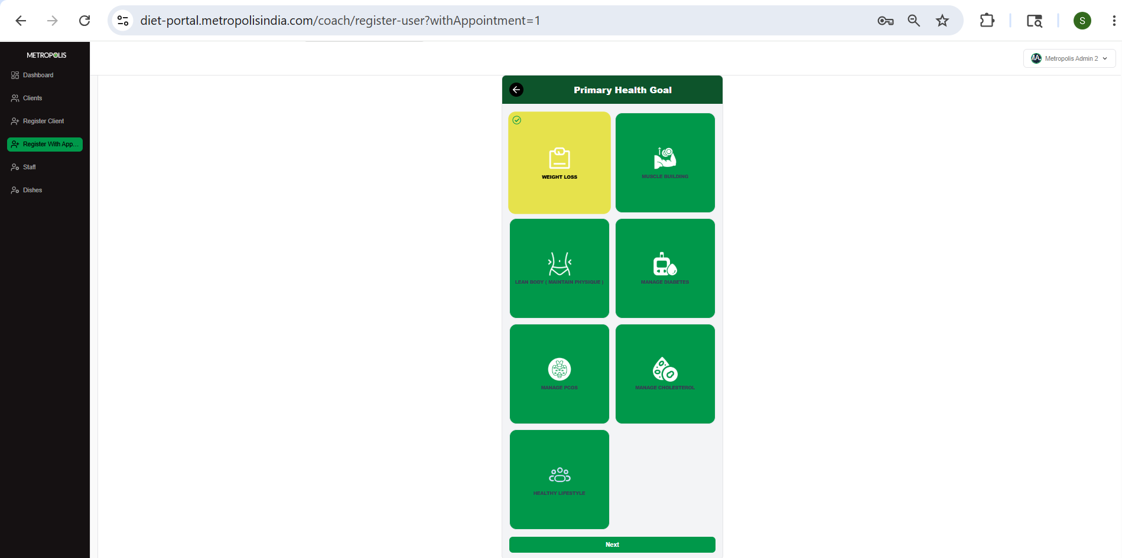

Slide 7
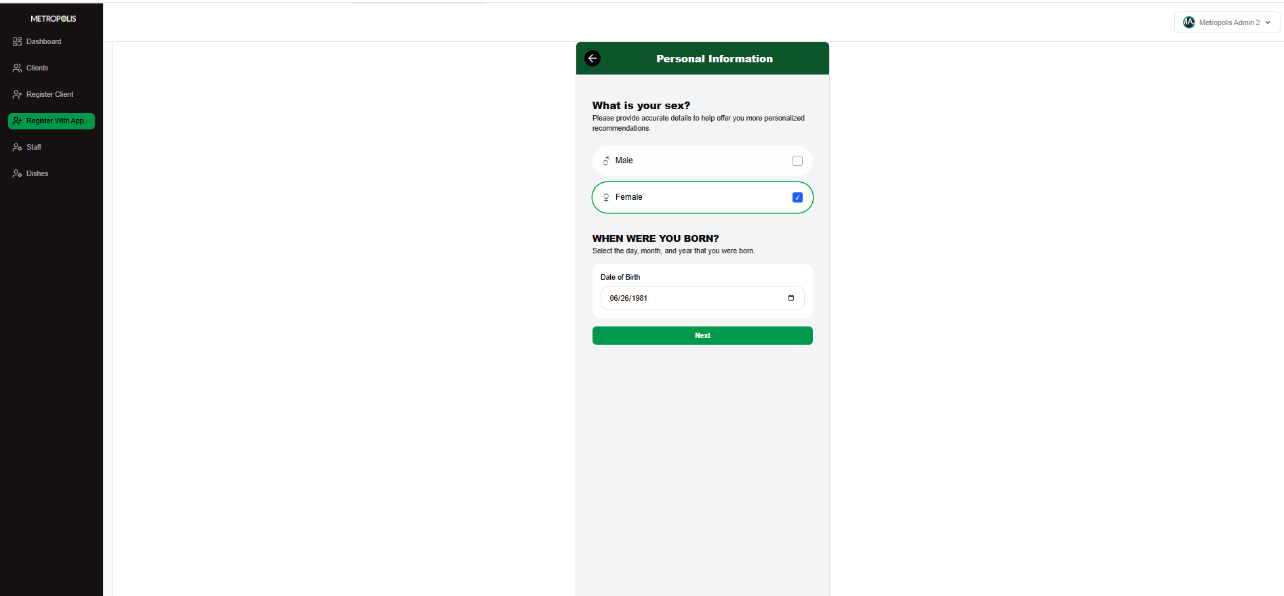

Slide 8
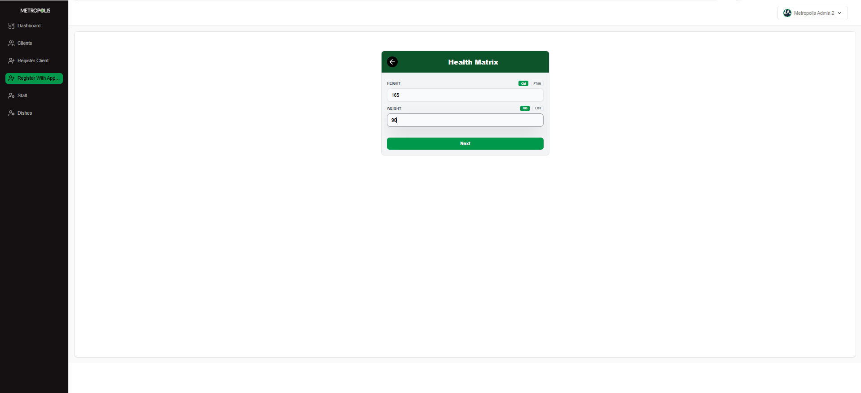

Slide 9
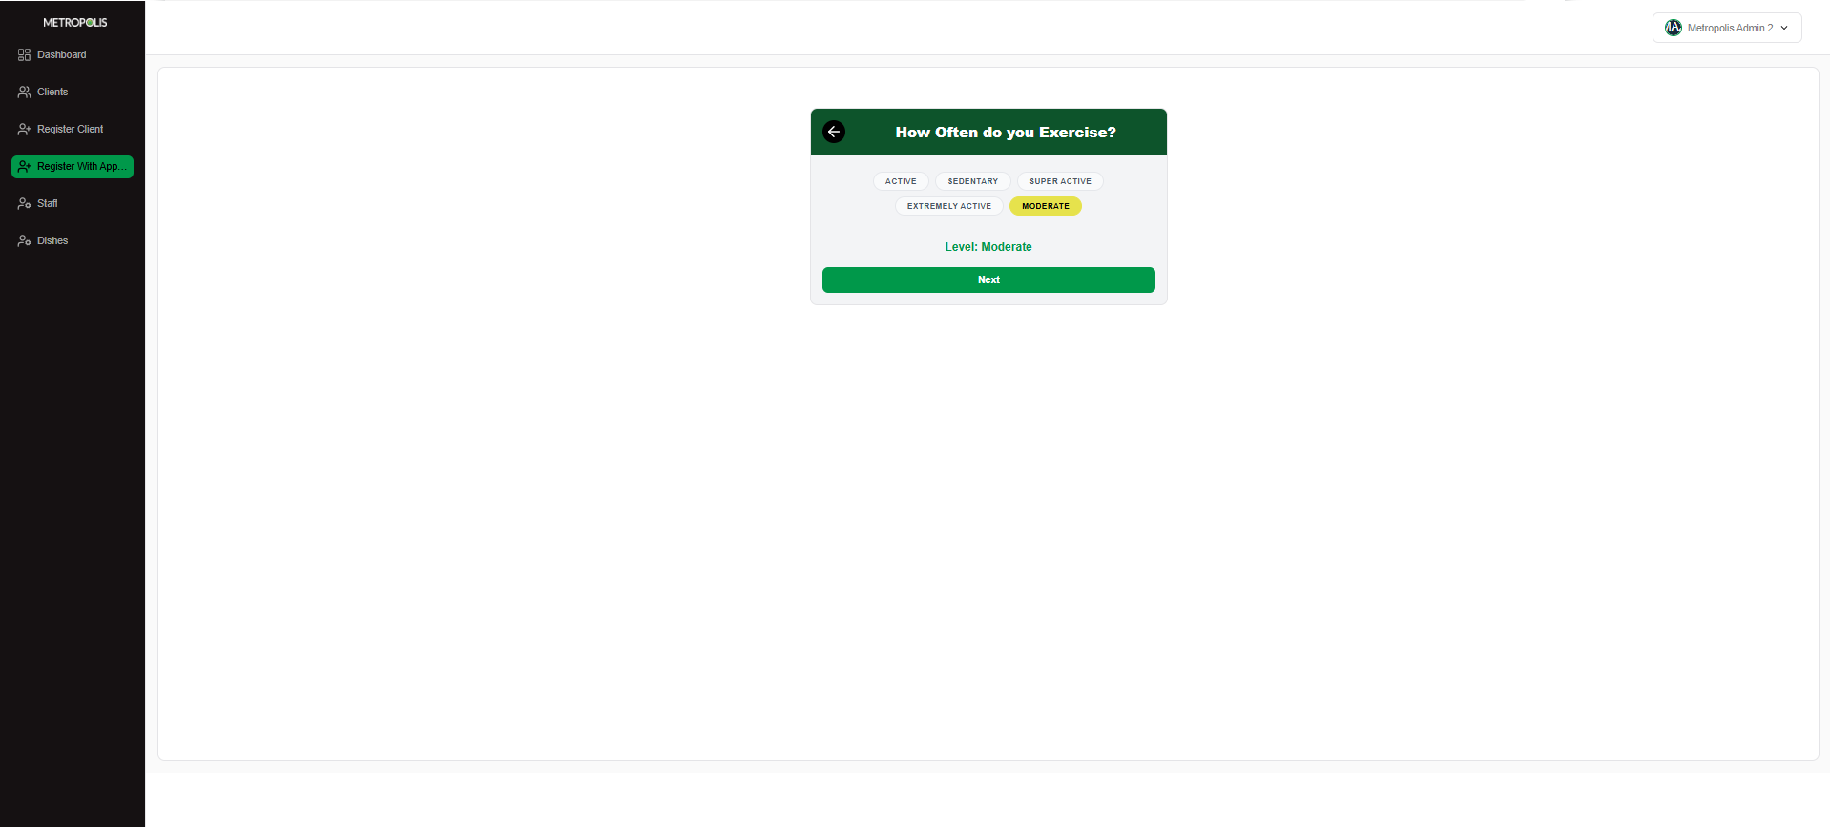

Slide 10
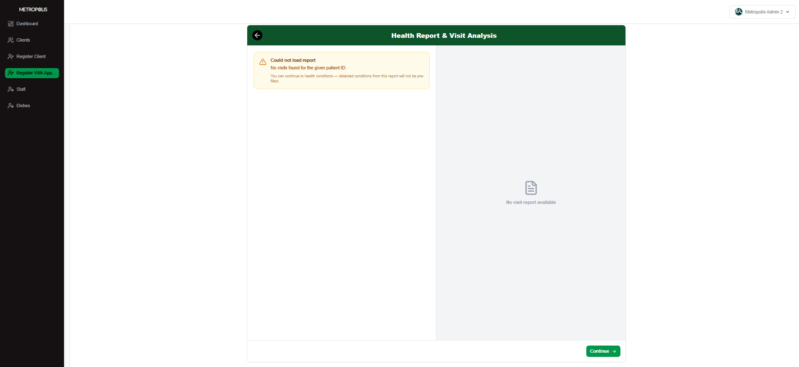
Notes:
This Patient does not have any reports.

Slide 11
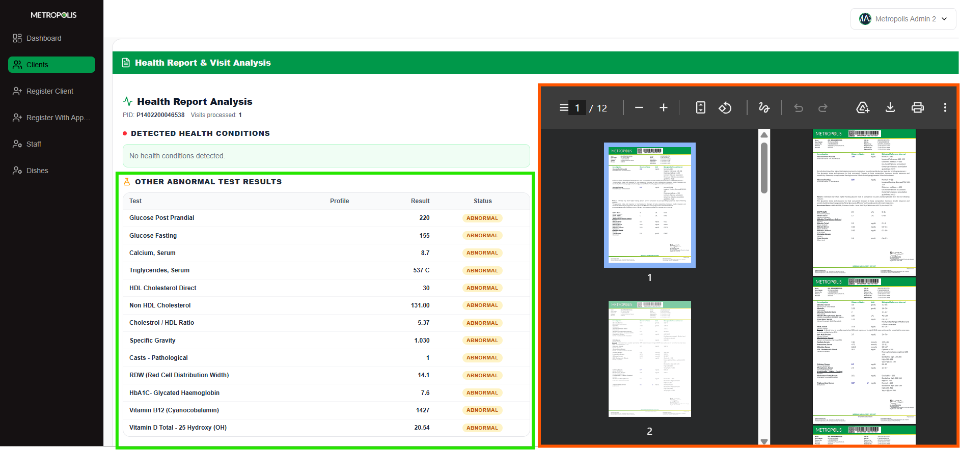
Notes:
The patient test results and test papers are displayed here to enable Agent to pitch by observing the abnormalities.

Slide 12
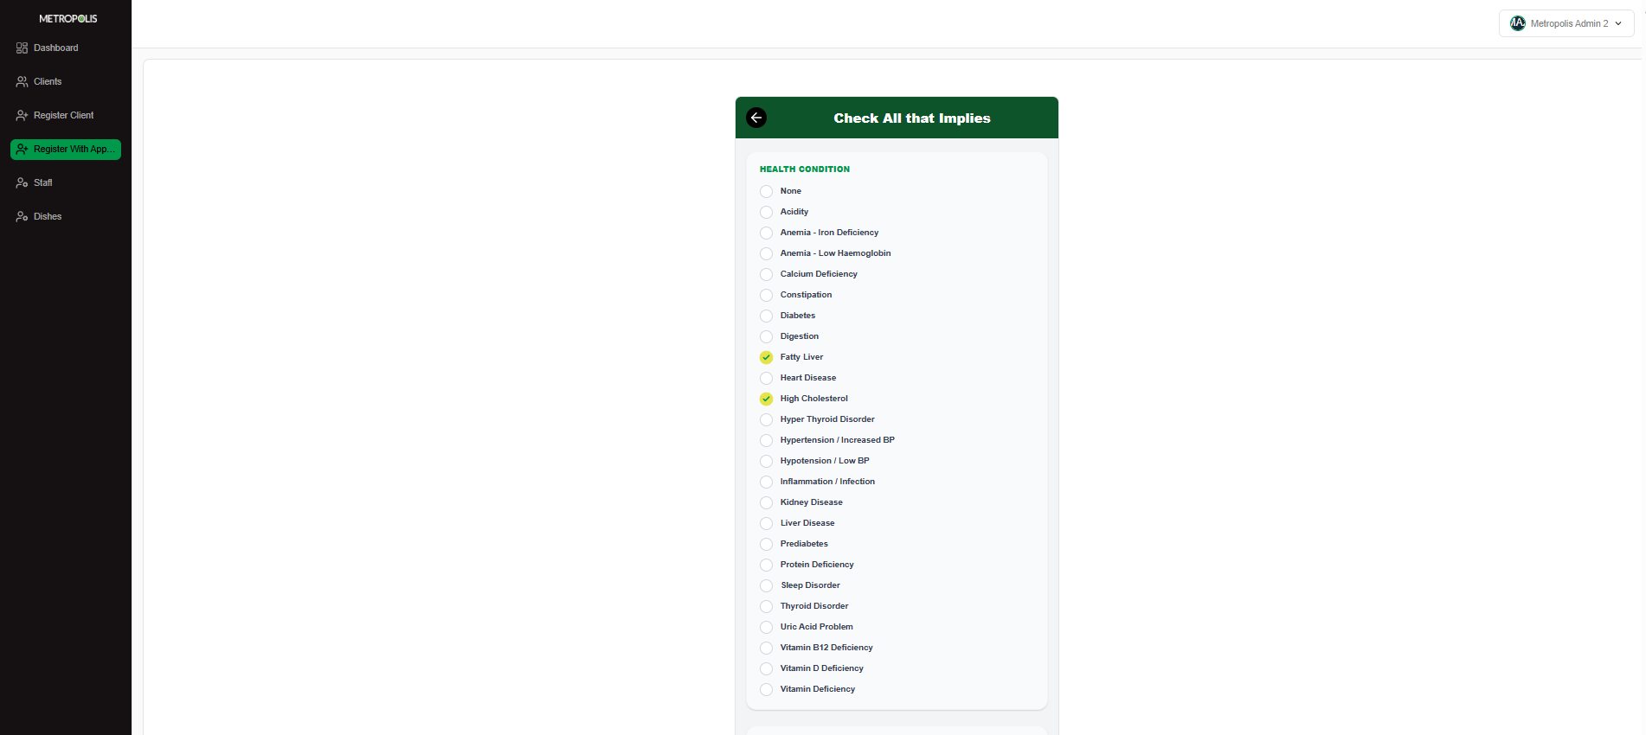

Slide 13
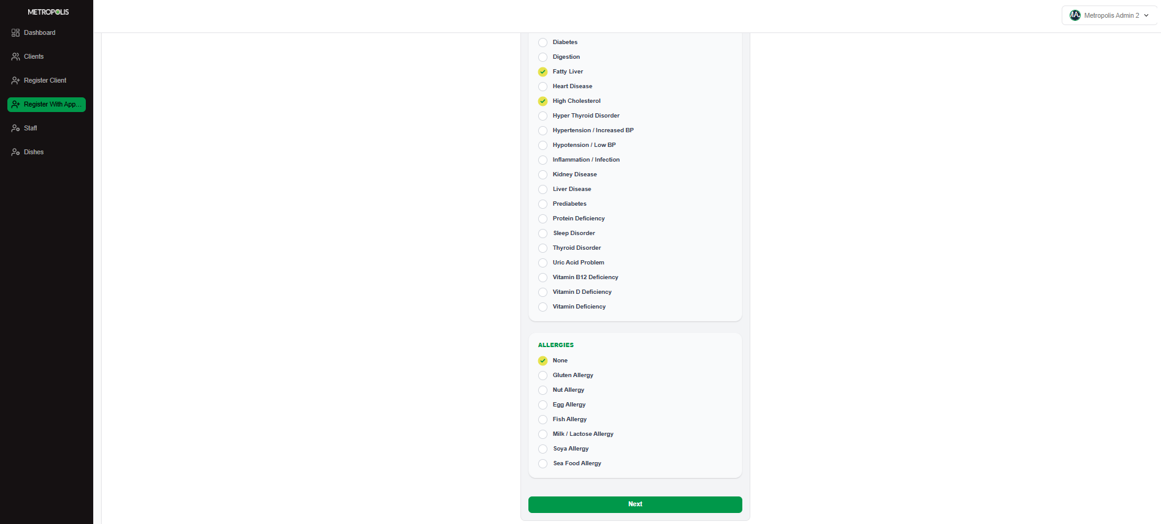

Slide 14
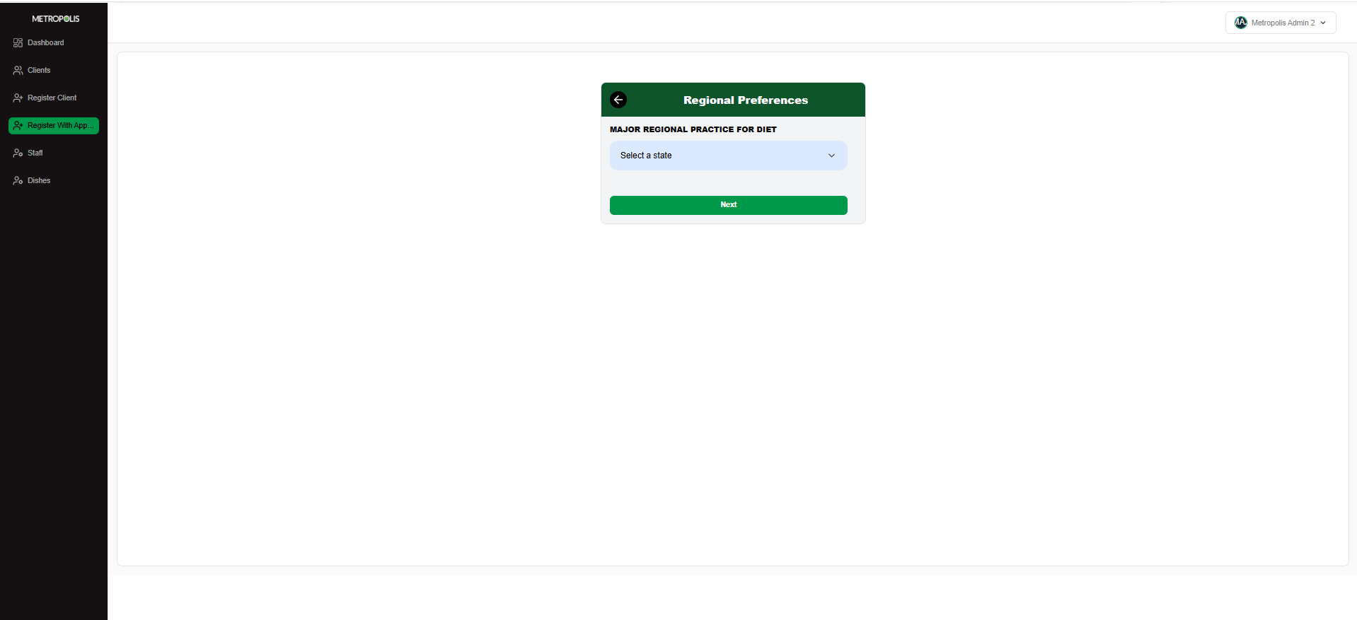
Notes:
Here the patient can choose any diet as per his regional choice.

Slide 15
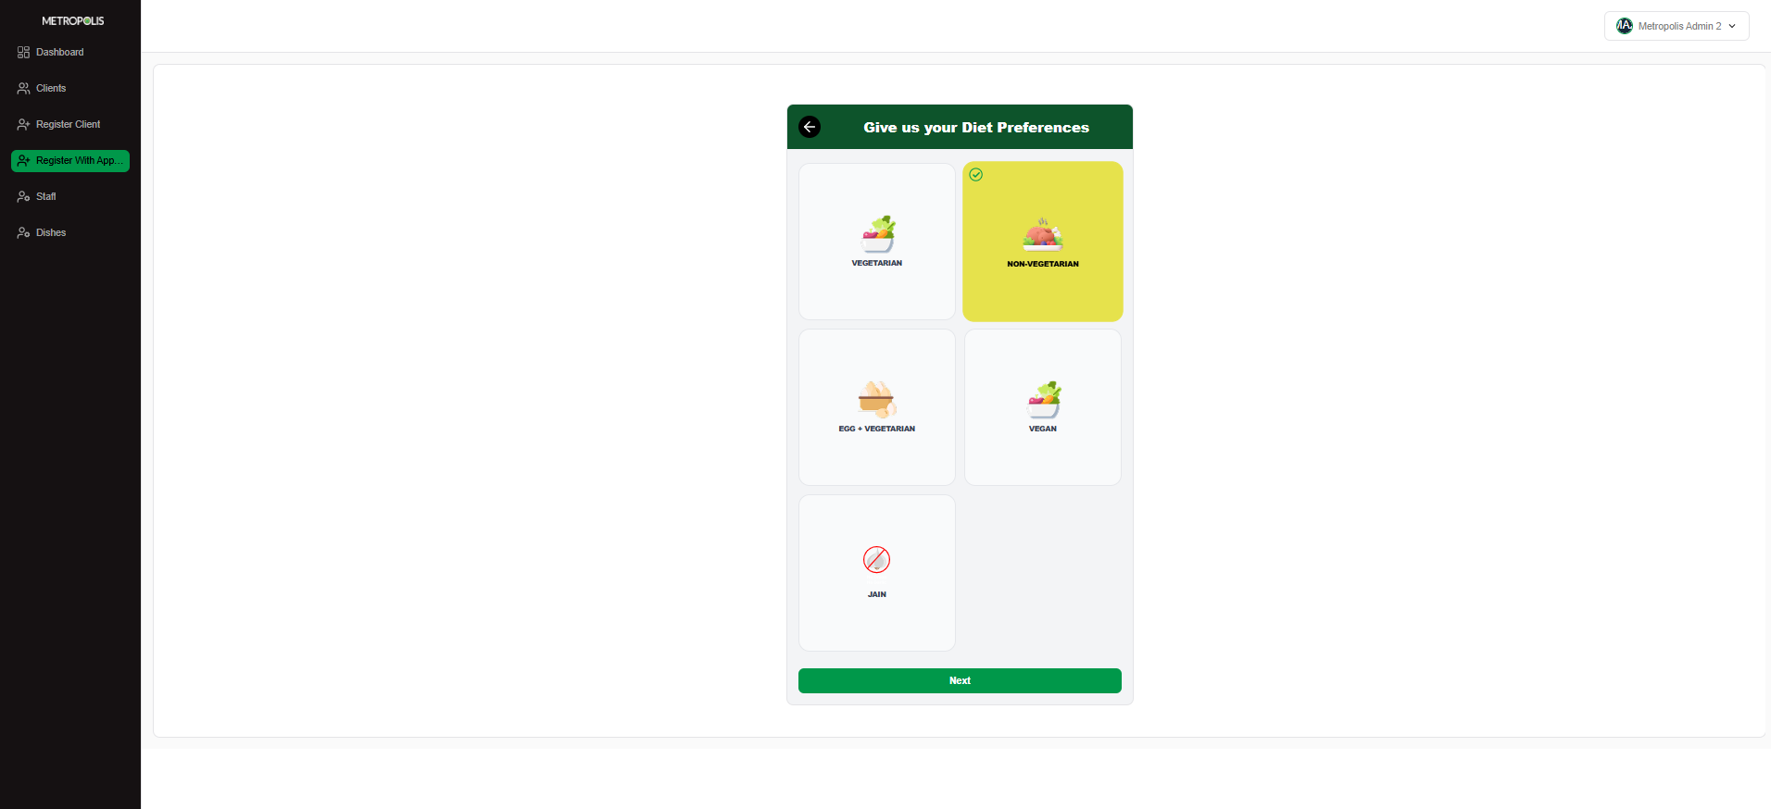

Slide 16
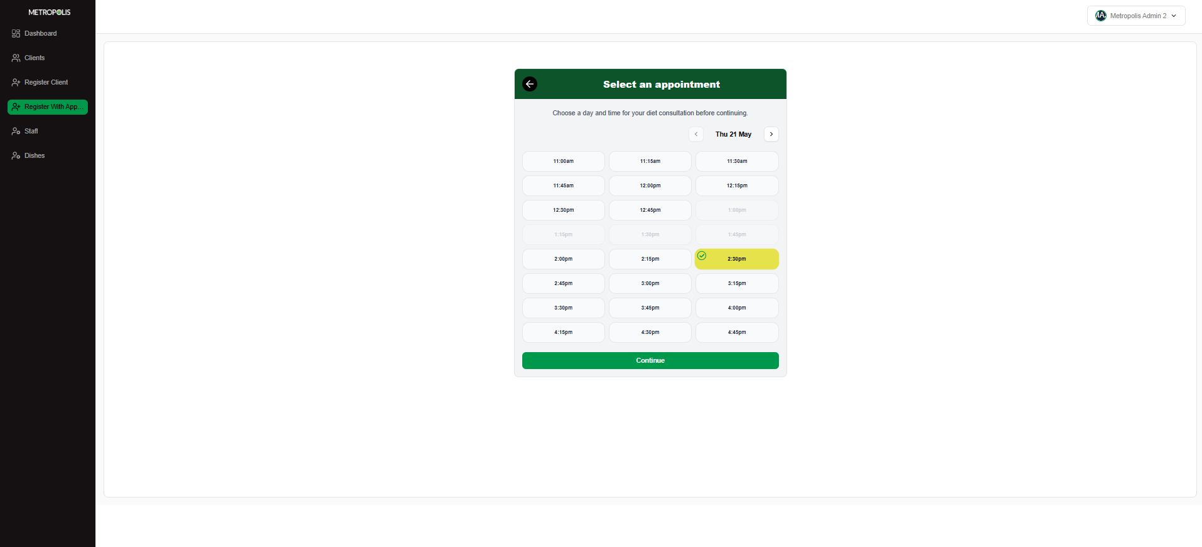

Slide 17
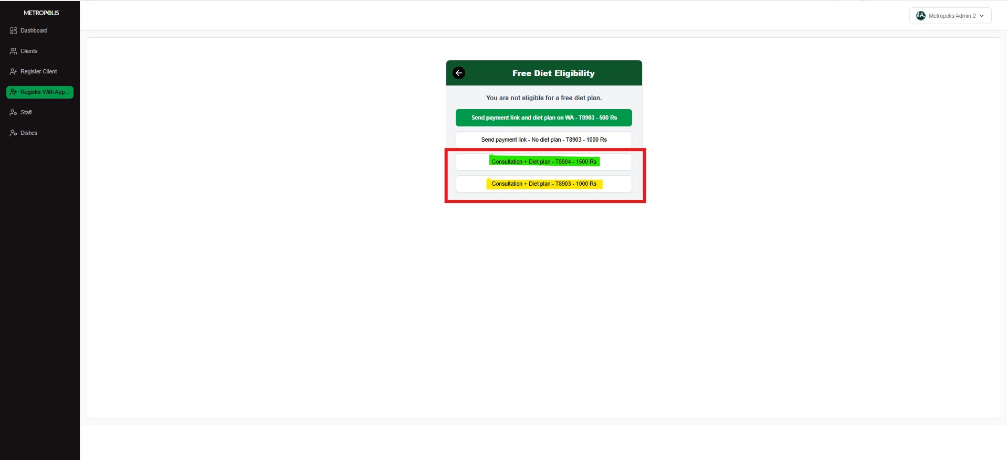
Notes:
Agent needs to pitch for Rs 1500 Plan

Slide 18
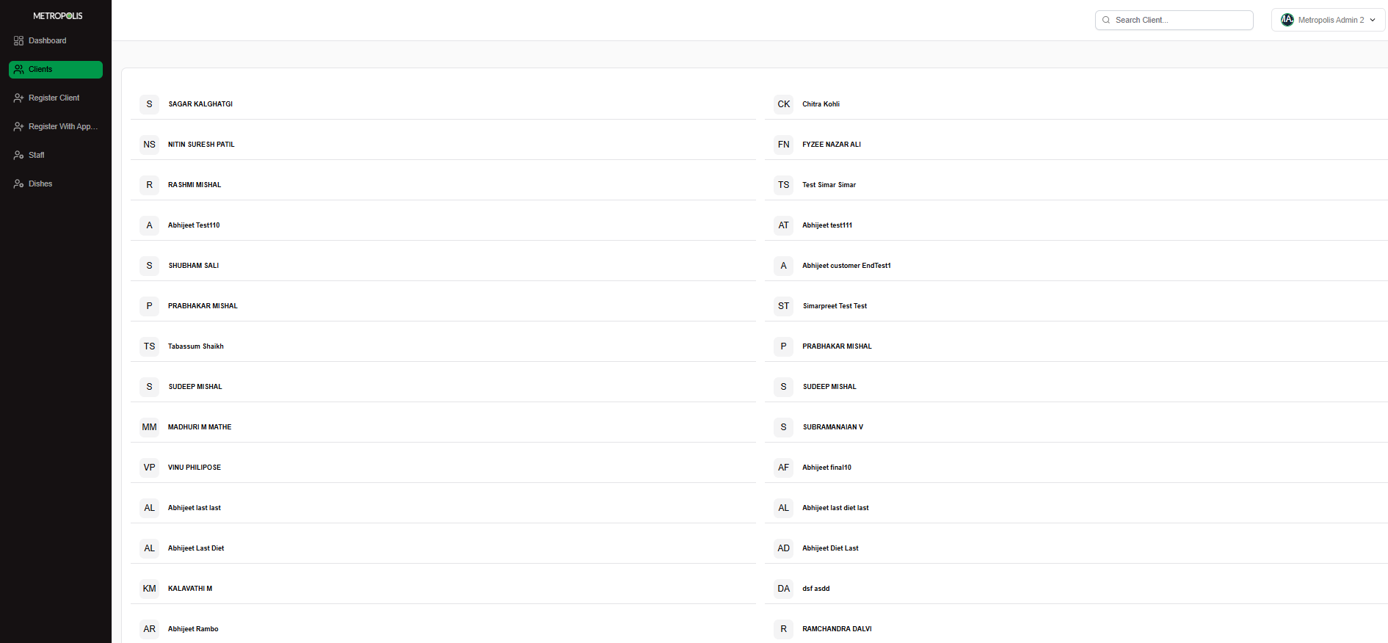

Slide 19
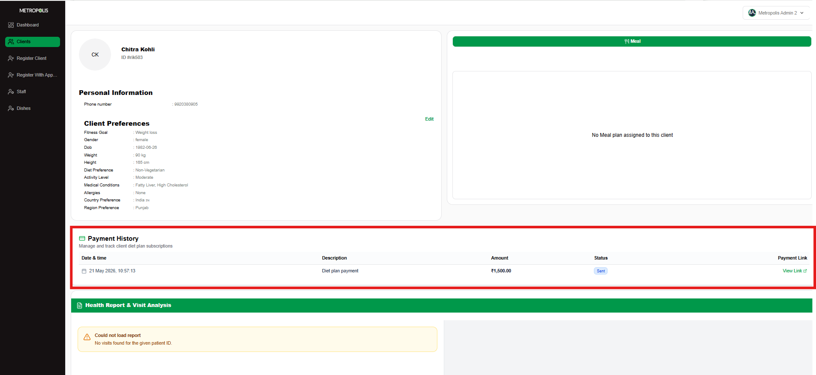
Notes:
The Pateint Payment status will be visible here

Slide 20
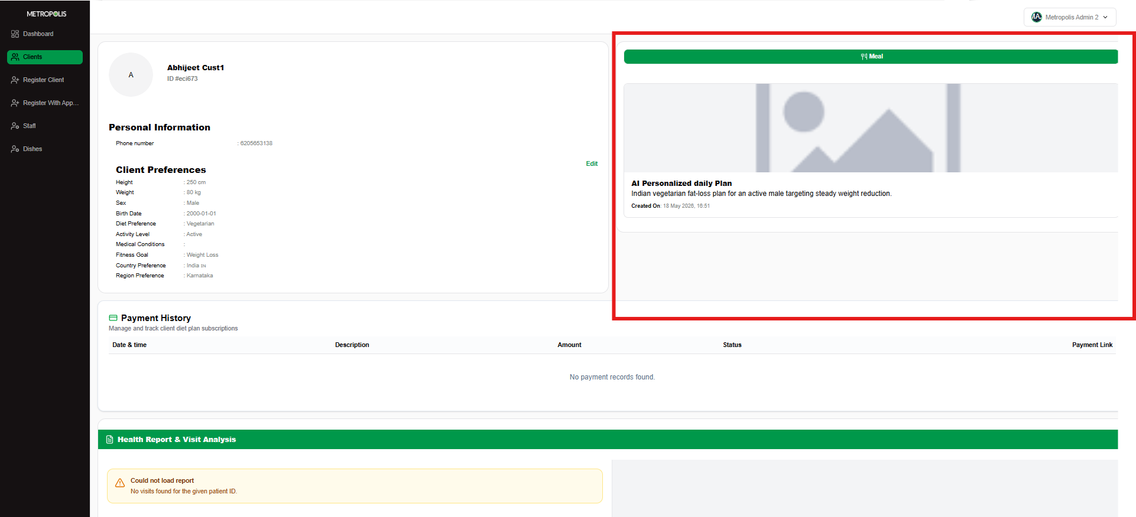
Notes:
The Diet plan can be checked in this section

Slide 21
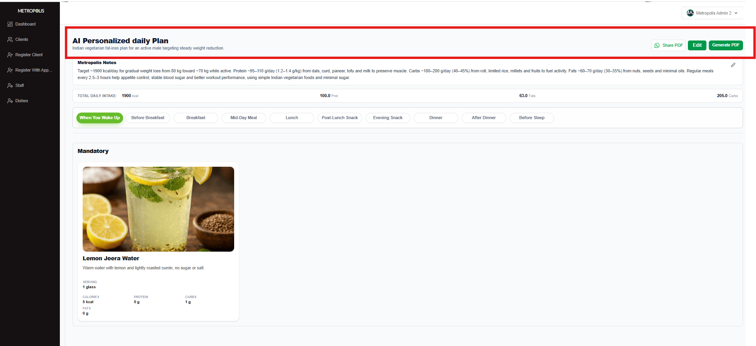
Notes:
Agent can send Diet plan to Patients register number or can download the plan here.

Slide 22
